Slide 1
Augmented Reality for Fun and Profit
By Sean T. McBeth
@Sean_McBeth
sean@seanmcbeth.com

Slide 2
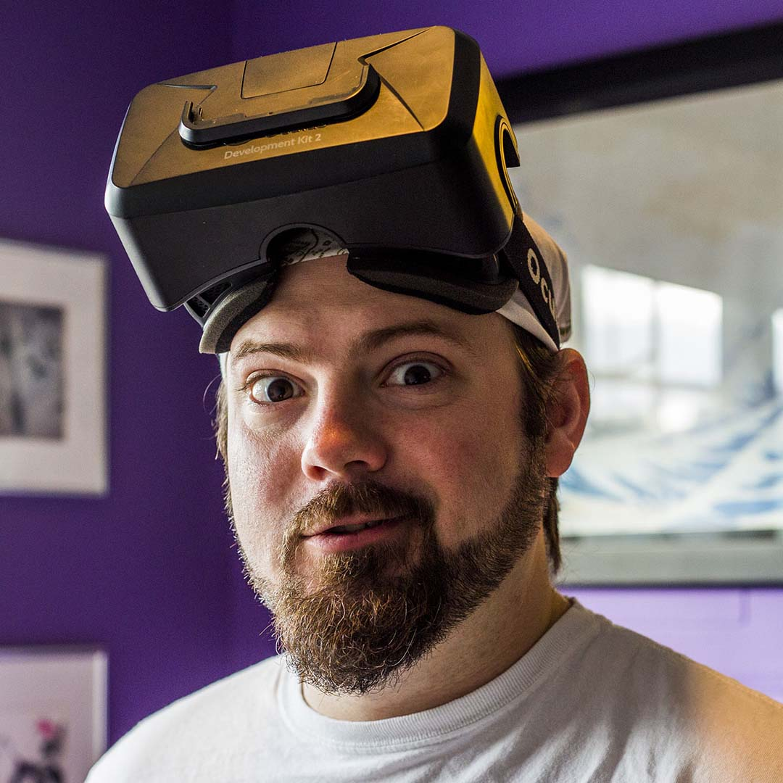
Sean T. McBeth
20 years of programming experience
(literal grey beard)
Worked in lots of different industries
Geographic Information Systems
Internet of Things
Machine Vision
Augmented Reality
Virtual Reality
Forgotten/forcefully suppressed knowing more languages than I can count
Not necessarily a duck
Pretty sure nobody is reading this far

Slide 3

Notes:
I’m a father of two kids

Slide 4
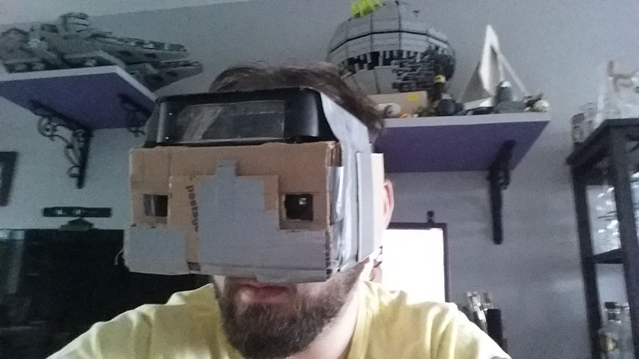
Notes:
I’ve been developing VR and AR software since 2012. I built my first AR apps as HTML5 camera apps for building stereo photos. I built my first VR headset out of a Samsung Galaxy Note 3, a few months before Google Cardboard was announced.

Slide 5
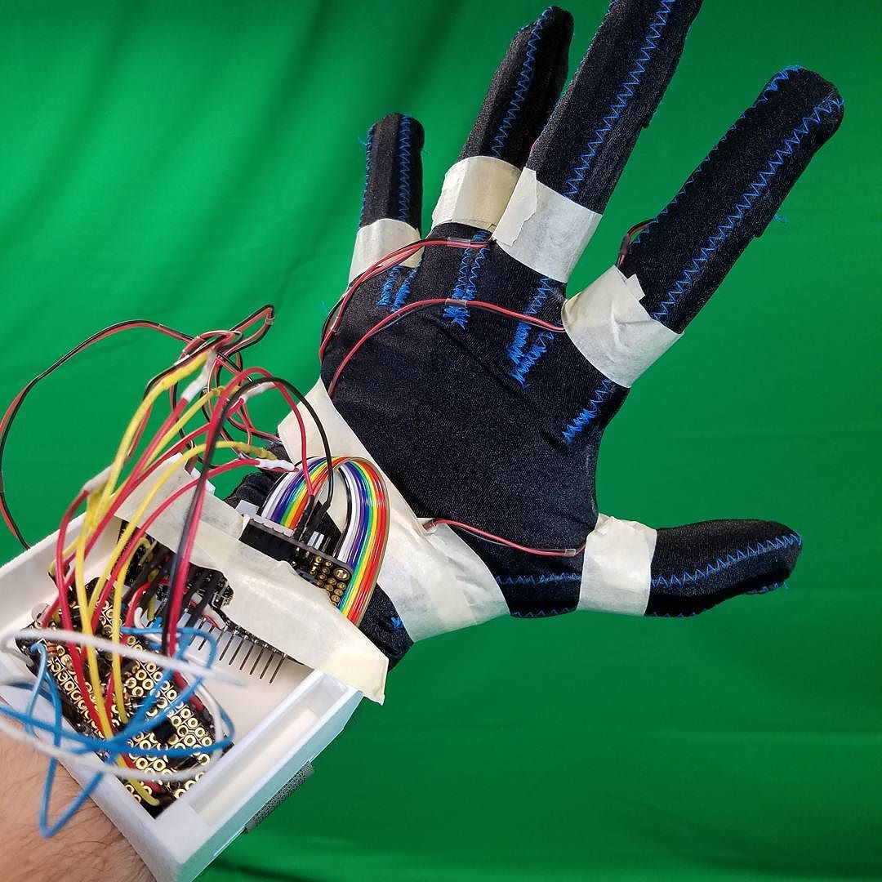
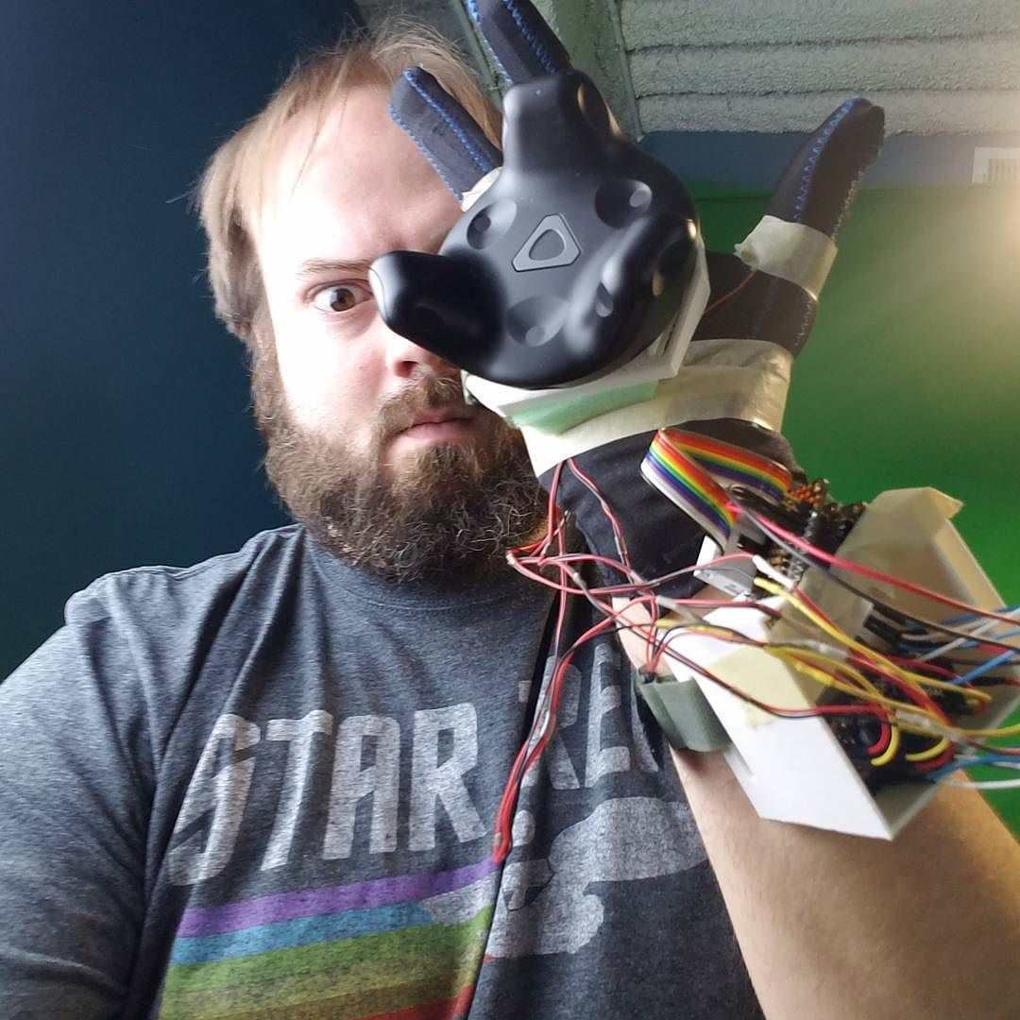
Notes:
I also hack on hardware. This is my *third* haptic glove prototype. It uses SteamVR tracking through the Vive Tracking Puck, and communicates completely wirelessly over Bluetooth LE to any smartphone or BLE-capable PC. There is a flex sensor and vibration motor in each finger. At the time that I built it, it was impossible to buy a haptic glove. Today, it’s technically possible, but all of the available devices are significantly more expensive than the sum-total cost of building this prototype.

Slide 6
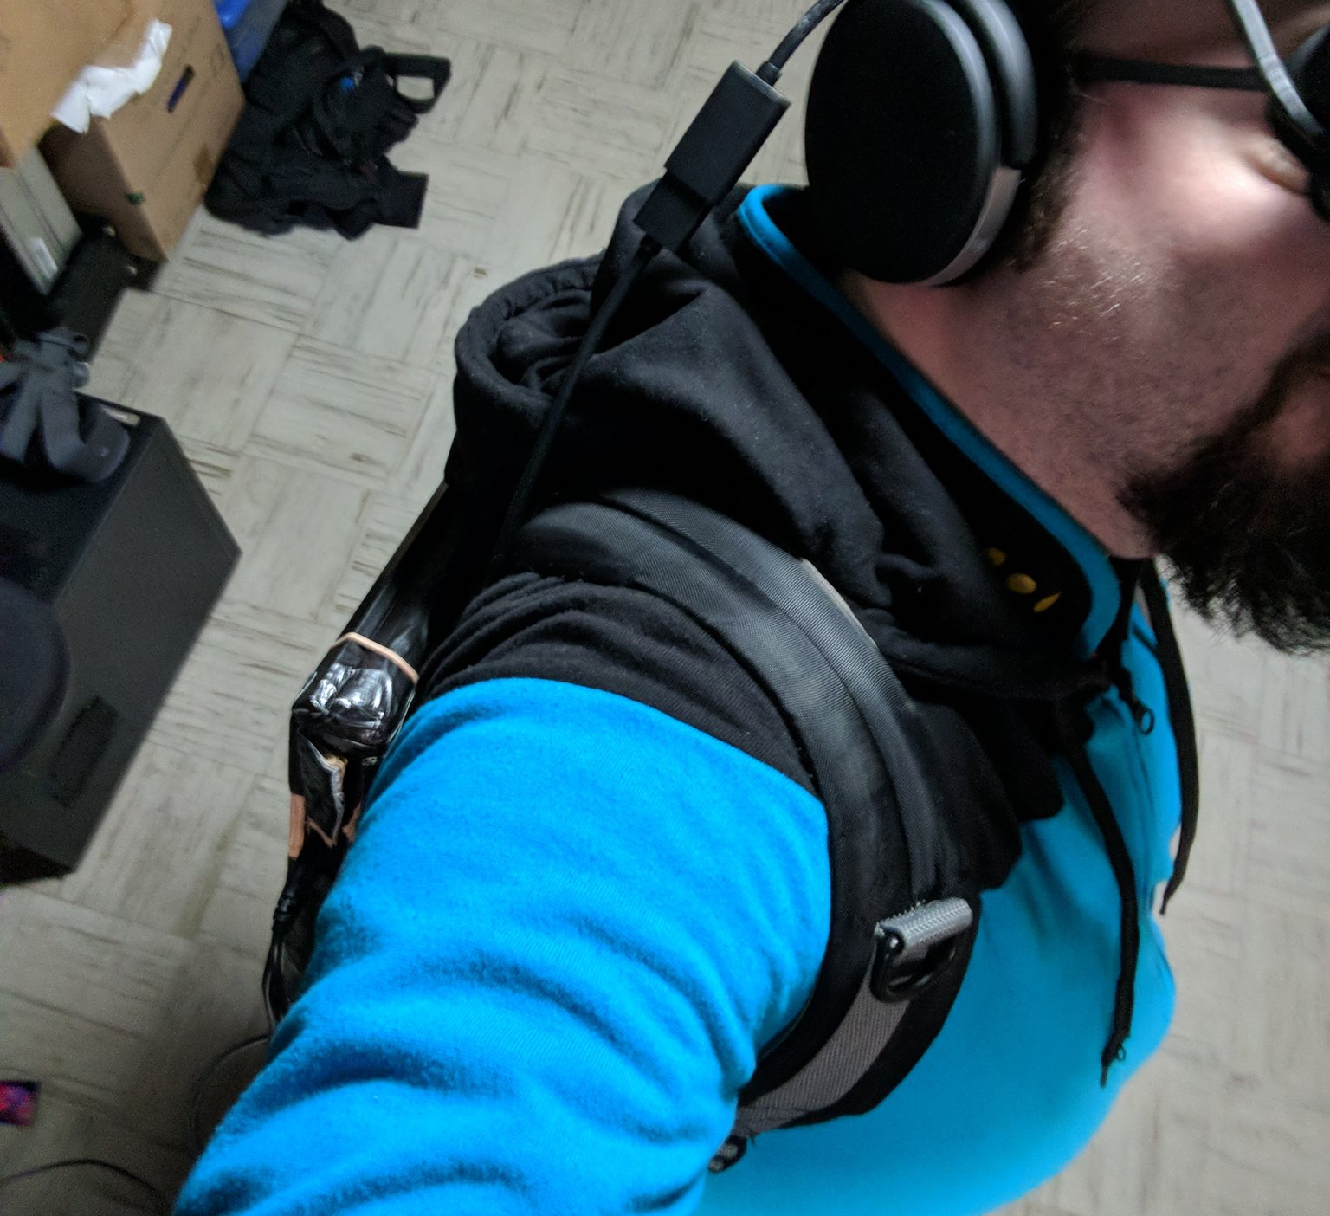
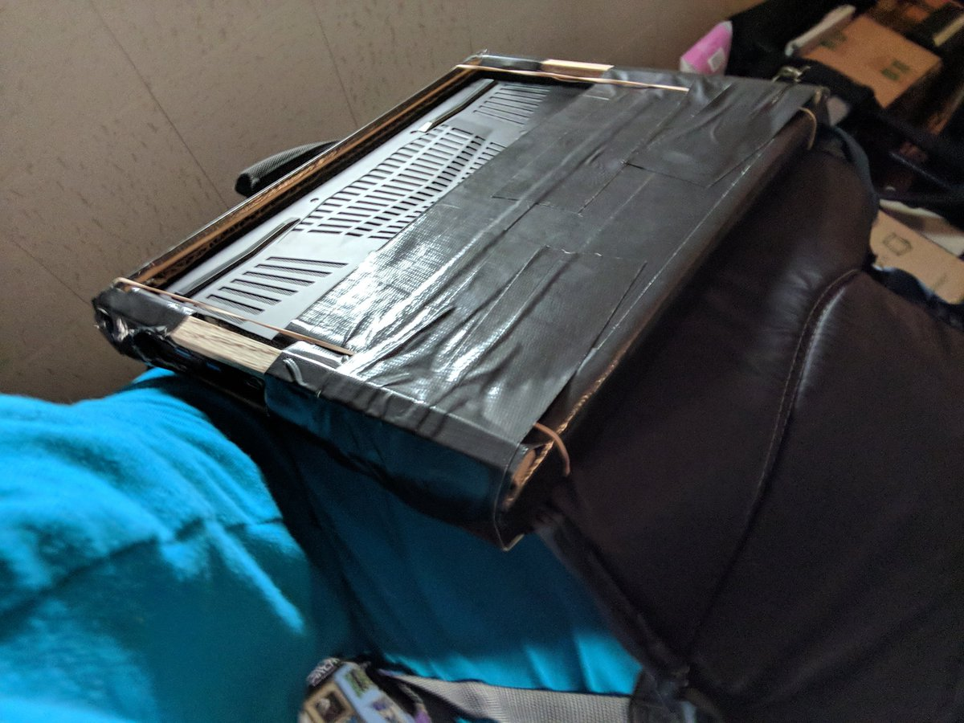
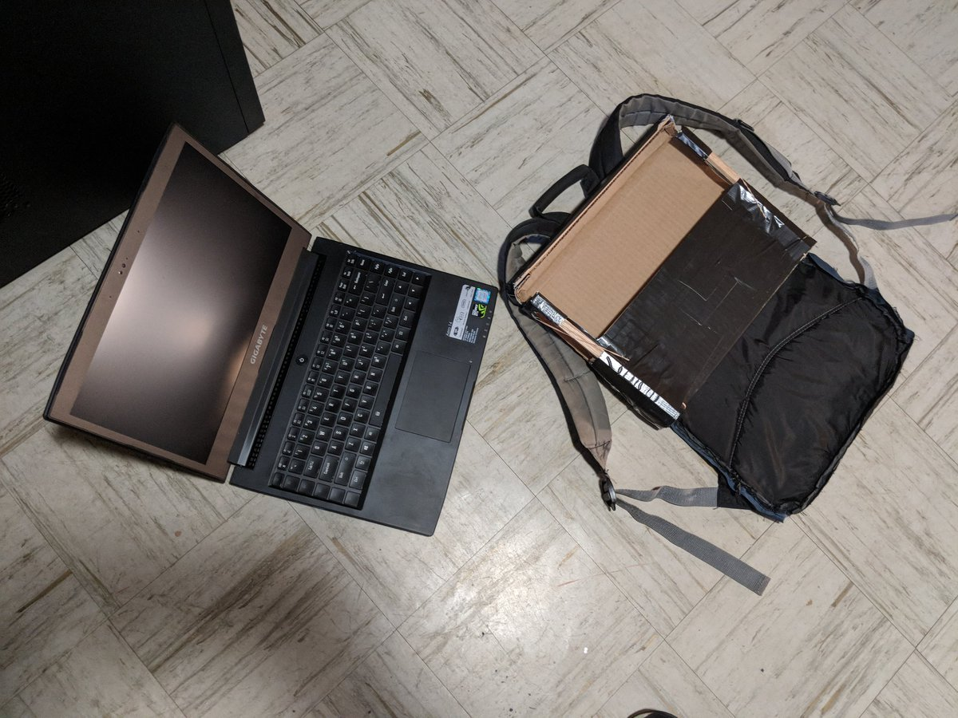
Notes:
This was the first VR backpack computer that I built. Note the prominent vents for heat distribution. I used the HP Windows MR headset for a completely “tetherless” experience. A future version incorporated a battery pack for extended, ultra-high-performance use. I see this as a benchmark in mobile VR. In 2017, we could have completely mobile VR for about $2000, at about 10 lbs, for about 3 hours of runtime. Two years later, with devices like the Oculus Quest, we can have it for about $400, at less than 1.5lbs, for the same 3 hours. The trajectory of technological improvement is staggering.

Slide 7


Notes:
I’m also an amateur photographer, which came about as a result of my life-long interest in optics.

Slide 8
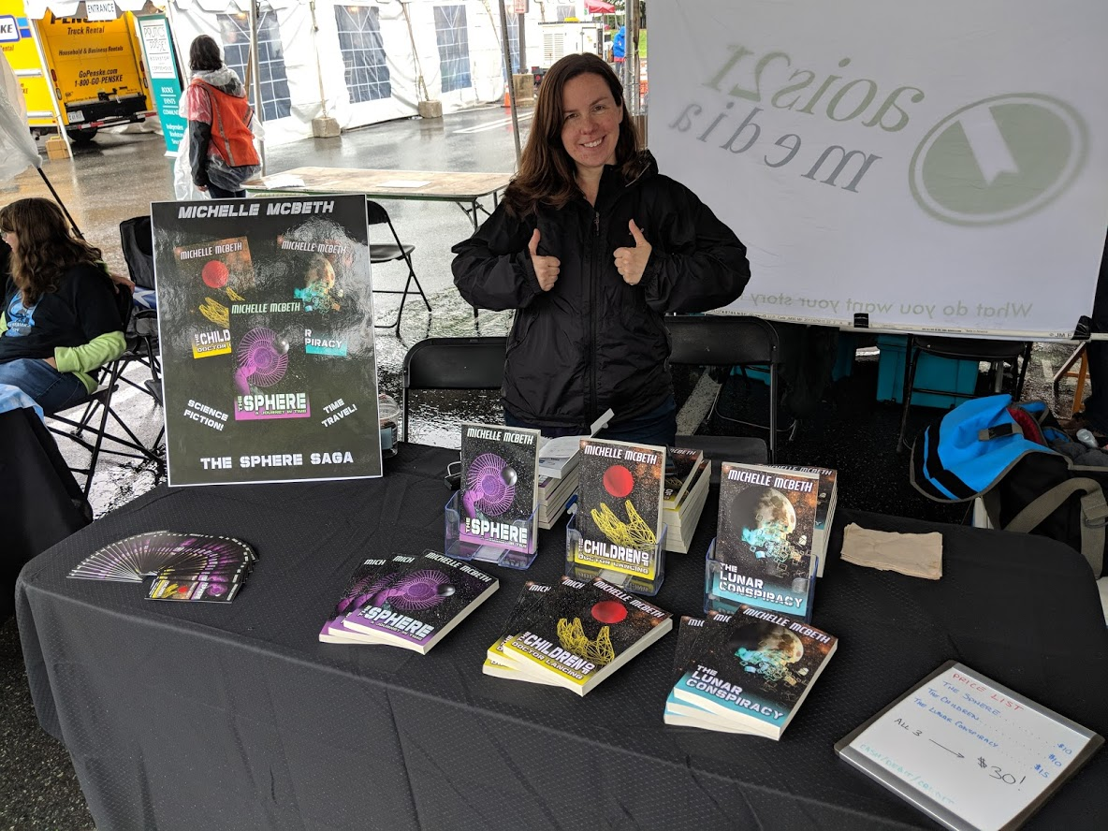
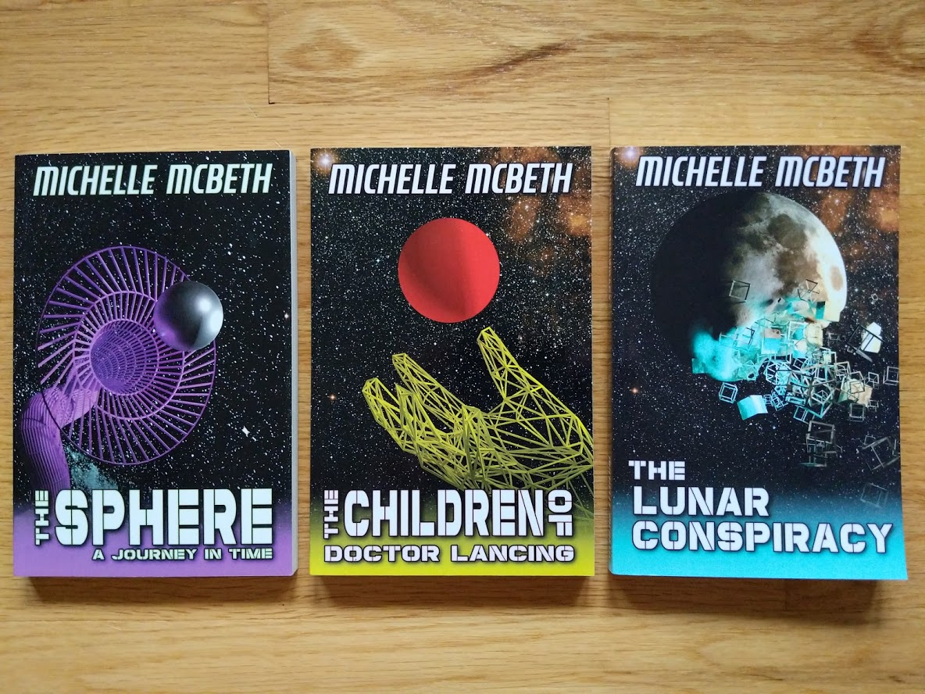
Notes:
And I occasionally dabble in 3D modelling, which I use to design book covers for my wife’s sci-fi novels. Check them out at https://www.amazon.com/Michelle-McBeth/e/B00RTXCEI2

Slide 9






What exactly is
Augmented Reality?

Slide 10
Let’s get it out of the way…
Notes:
Everyone mentions it, so I’m going to address it right off the bat…

Slide 11
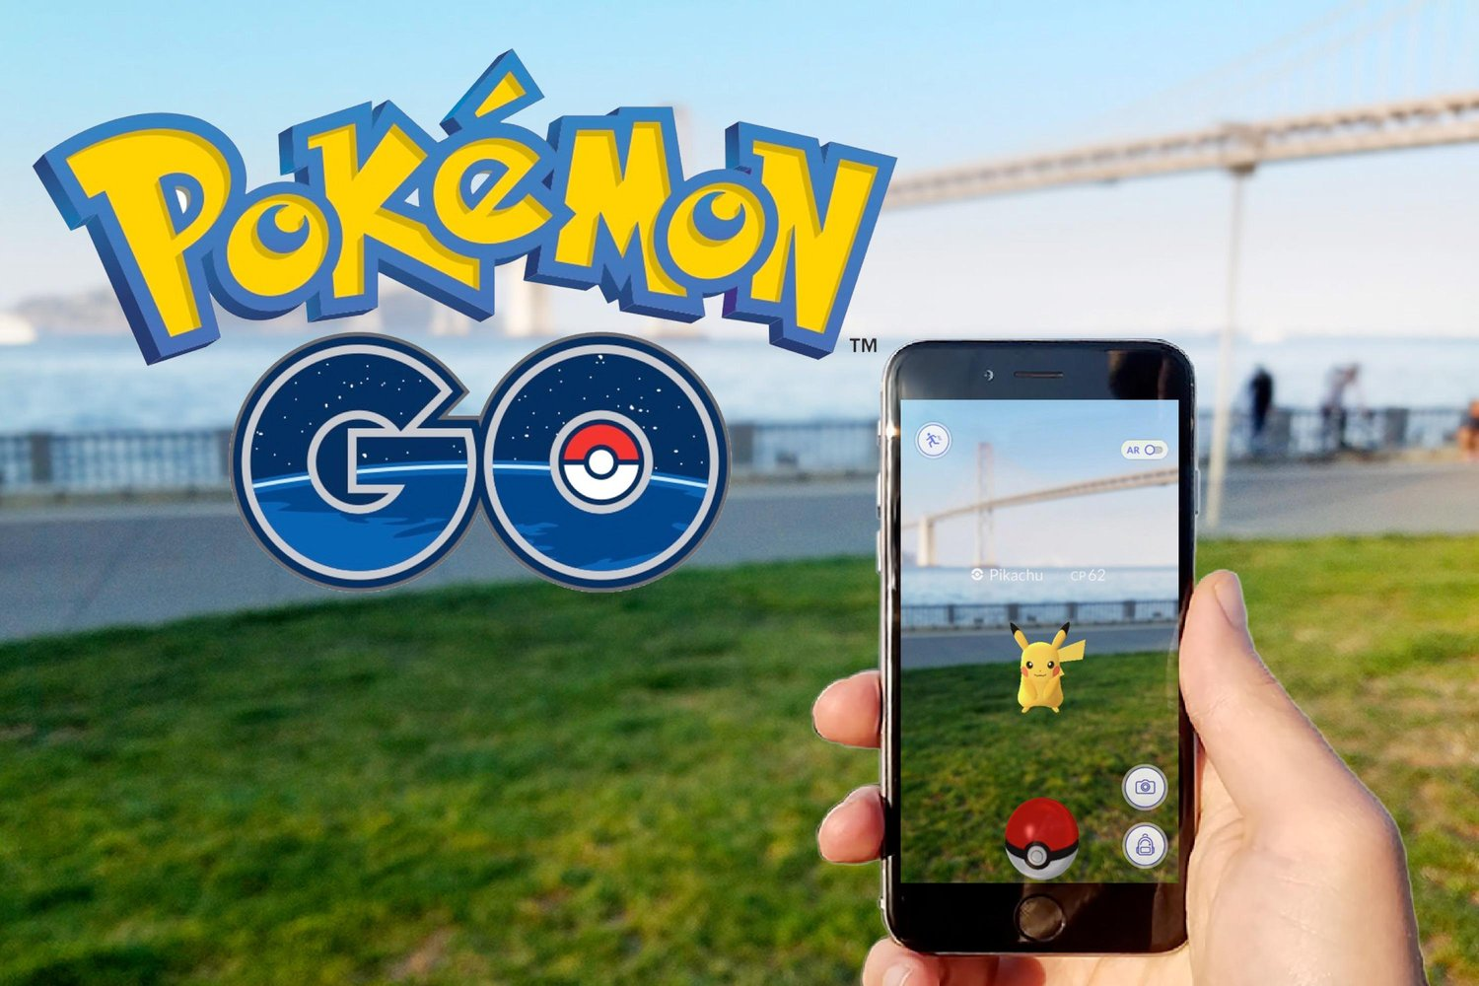
Notes:
Pokemon Go hit the market in mid-2016. It immediately became a darling of the tech-press as “the first, meaningful AR experience”.

Slide 12
But…
Notes:
But, in the sense that everyone talks about it, it is not Augmented Reality

Slide 13
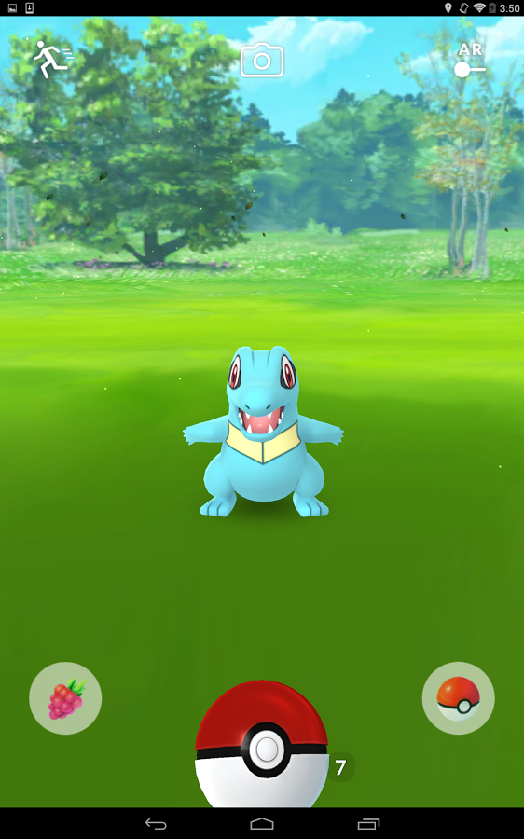
Notes:
Because the capture mini-game does not actually rely on real-world data. So much so that the vast majority of players turn off the AR view to save battery charge. Additionally, the AR view made the game harder to play, as it moved the characters around on the screen, making it hard to throw the capture ball at them.
For AR experts in the audience, please hold your questions, I know what you’re about to say and we will get back to it.

Slide 14
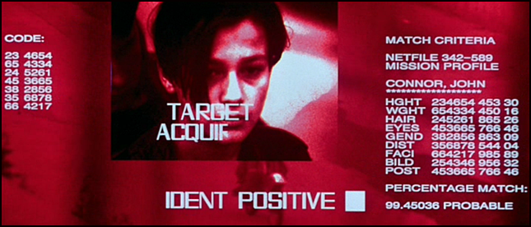
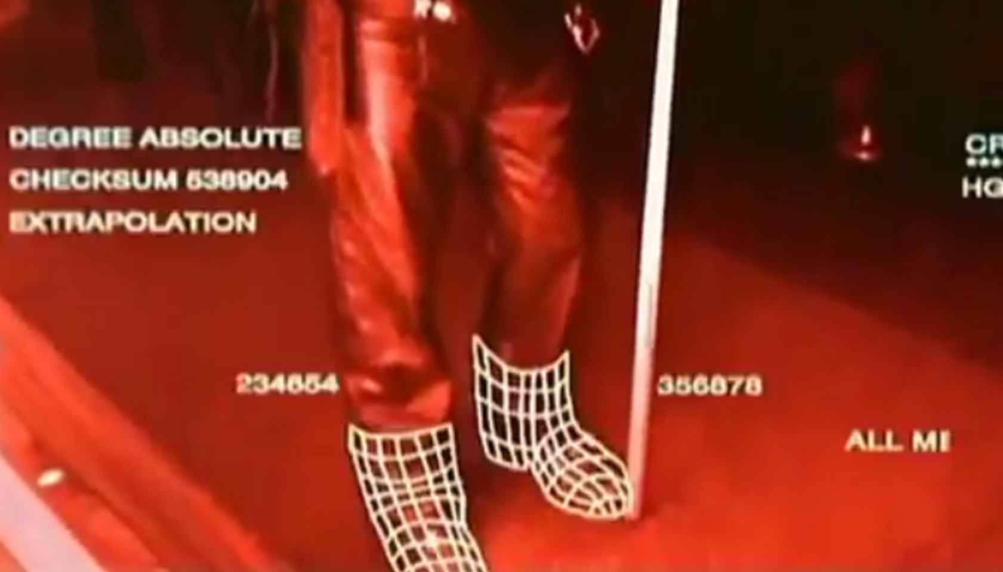
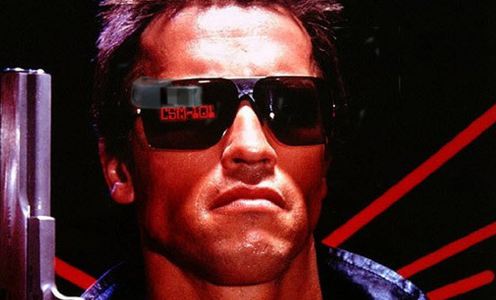
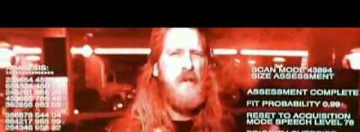
Notes:
Okay, so getting back into “what is AR?” It’s a concept that has existed in the public conscience for quite some time. Here are a few screenshots from The Terminator (1984 - Kathryn Bigelow’s ex-husband). We see some very basic examples of AR that are pretty visionary if you really think about what is being imagined. Data overlays on top of real-world images. Metrics being called out and correlated against databases of information.

Slide 15
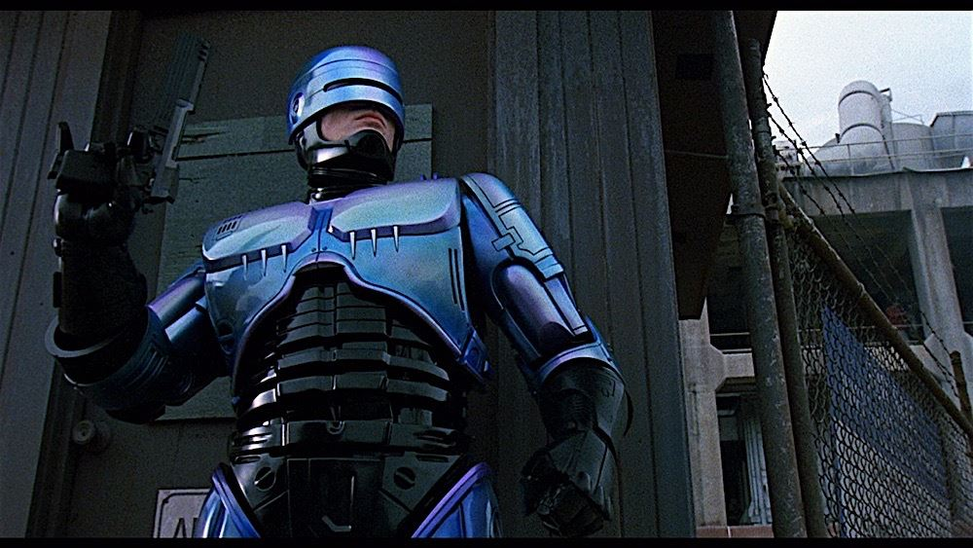
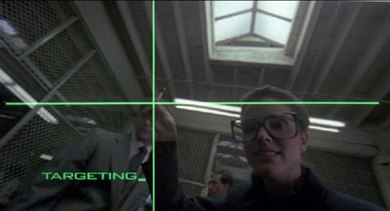
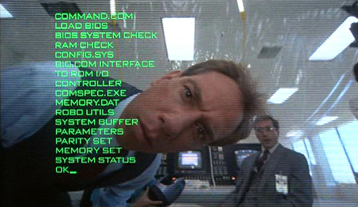
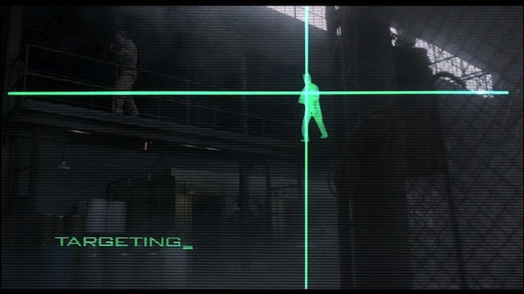
Notes:
We see it again a few years later in Robocop (1987 – Paul “I hate Robert Heinlein” Verhoven)

Slide 16
But…
Notes:
That doesn’t mean Pokemon Go is strictly not AR

Slide 17
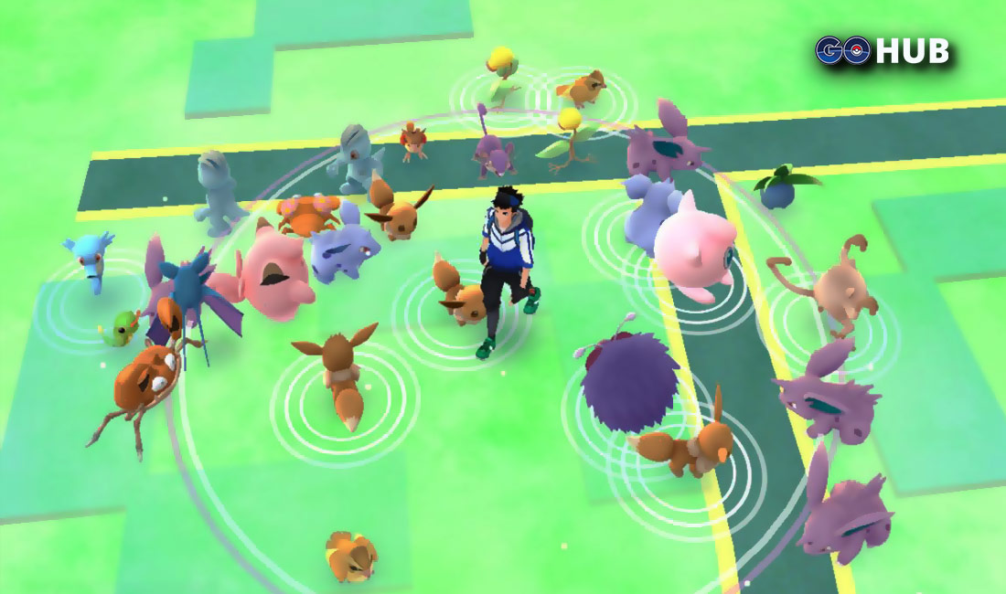
Notes:
It provides a view of the real world—an overworld map of our live location—with fantastical data applied on top.

Slide 18
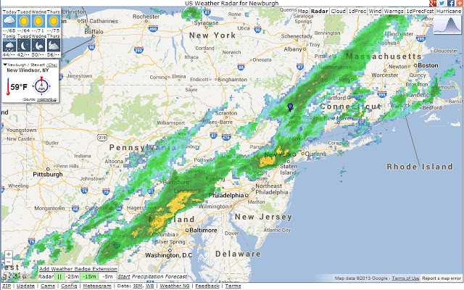
Notes:
This is not so far off from other applications, like live weather maps

Slide 19
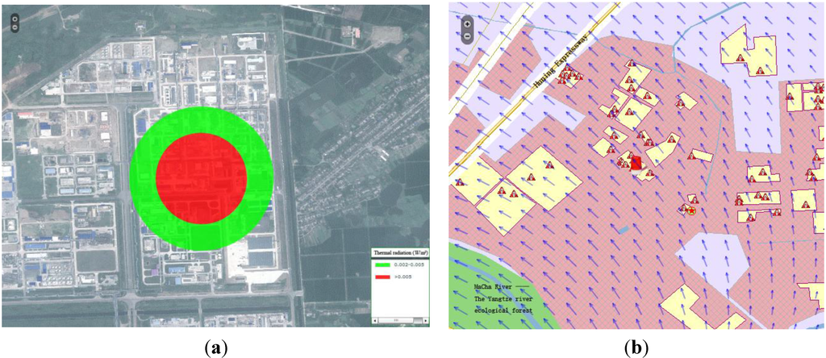
Notes:
In the early 2000s, I worked on a system for emergency first-responders to manage operations in toxic gas cloud situations. We modelled gas propagation using live data about disaster events and mapped them against databases of GIS data and live weather data. We provided GPS integration to show emergency service’s location in relation to estimated propagation, given them valuable data on how to avoid contamination or target evacuation.

Slide 20
But also…
Notes:
There are other areas in which AR has already penetrated our daily lives.

Slide 21
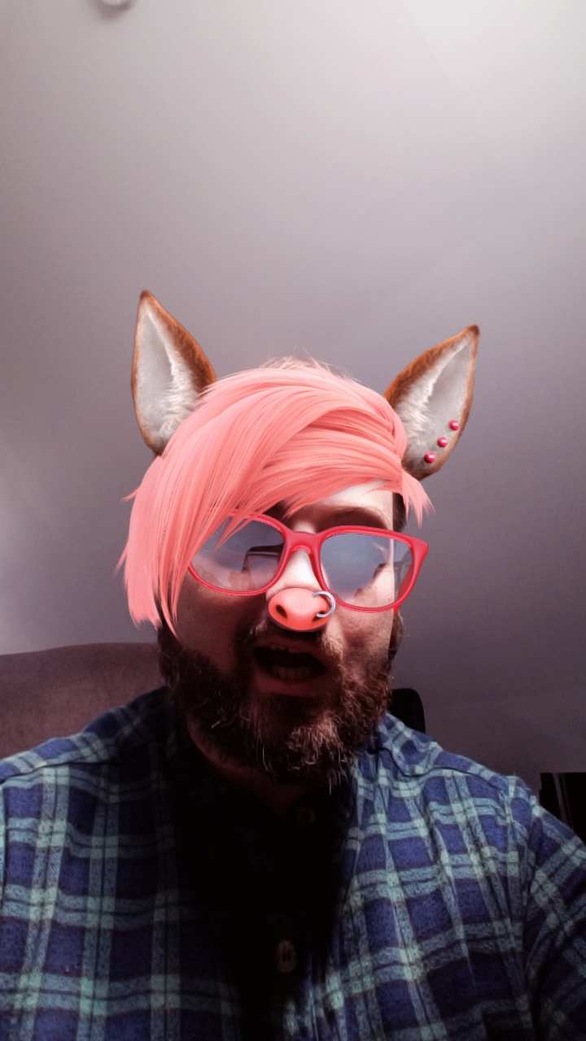

Notes:
Snapchat filters are a type of AR that rely on facial recognition, rather than 3D mapping and motion tracking. It gives us the ability to completely reimagine ourselves.

Slide 22


Notes:
It’s easy to imagine a very, very near future in which a pair of glasses will then allow us to reimagine everyone else.

Slide 23
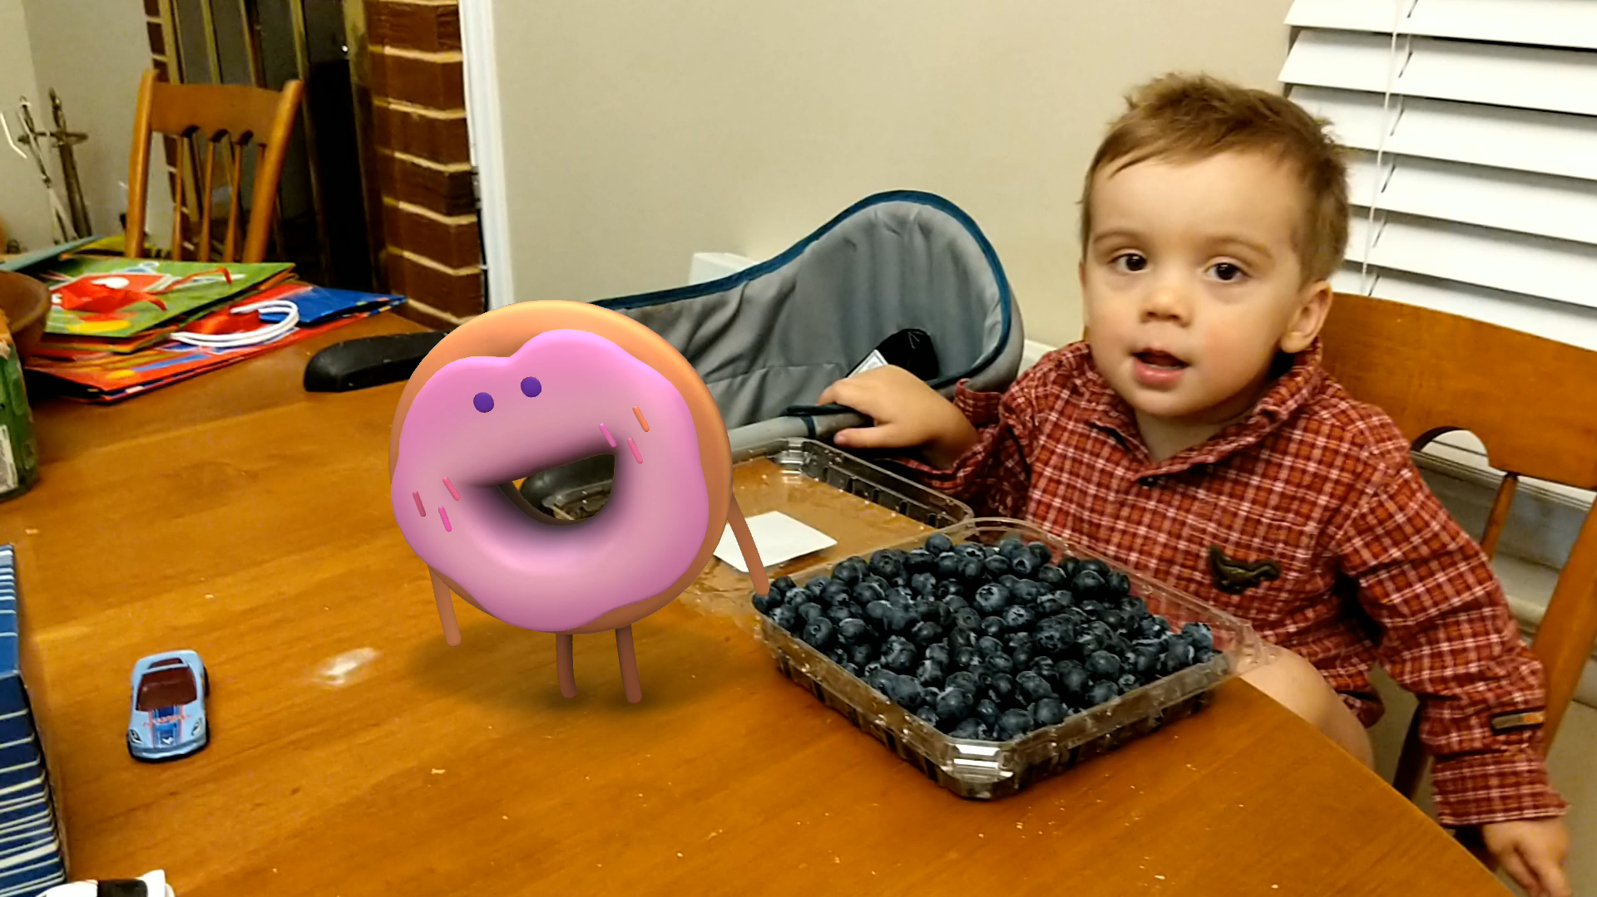
Notes:
We can also alter our recordings of memories. This is a feature of the default Android camera app called “AR Stickers”. It’s fascinating to think of the implications. Human memory is unreliable and incomplete, so we rely on recordings to fill in the gaps and remind us of the true order of events. Without the recordings, our memory of events shifts and fades, but the recording reset us to a baseline understanding. As AR technology improves, we will eventually come to understand the world and our lives in fantastical settings with very little thought as to the artifice of it.

Slide 24
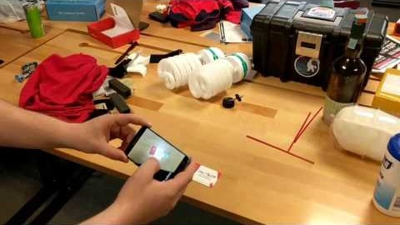
Notes:
Here is one of my early AR demos. It uses Vuforia to augment a standard business card, providing extra detail that would not fit in the bounds of the card. This demonstrates a future in which context-sensitive data is freely browsable without the need to jump out-of-band to a browser or QR-code scanning app to proactively search for information.

Slide 25
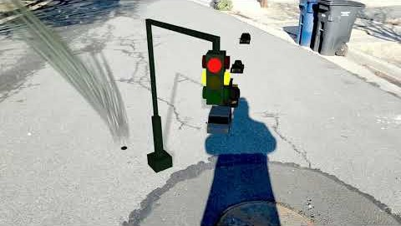
Notes:
Here is another AR demo I built, performing traffic simulations with realistic light estimation in the real world. One might imagine how scaling up an application like this would be a useful tool for city planning.

Slide 26
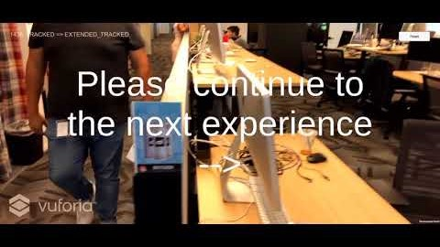
Notes:
This is a project I built at my previous job that demonstrates using very large marker images, replacing them with seamless surrogates, and augmenting new graphics on top. Where we might install a costly, energy-hungry digital bill-board or bus-stop advertisement today (that is also prone to failure in the harsh conditions of the outside environment), we can off-load all of that on to user devices, allowing individuals to decide if they want to have their public spaces cluttered and distracted with animations.

Slide 27



Notes:
This is an ersatz illustration of another application I built at work. Unfortunately, due to contractual restrictions, I am not able to share real video of the application. The air compressor hear is imagined as an IoT device, with the ability to report health metrics on its own operation. We use an AR headset to receive alerts to operational issues, and perform a guided repair process for user-serviceable issues. The process is recorded in a Case Management System, and the user has an option to call a technical expert for assistance, with a live “see-what-I-see” view that provides the technician the ability to annotate the object in live 3D.

Slide 28
Why?
Availability
Context
Communication
Notes:
Now that we have seen these examples, can we boil AR down to its core components? They would be:
Availability: being at the ready in a live scenario, without having to go back to a post-processed, historical view of data.
Context: the data that we are adding to the view has a relationship to the view itself
Communication: we are not cut off from the outside world, we have full access to the people and data sources that provide us with information beyond our own capacities.

Slide 29
Why?
Availability
Context
Communication
AKA why we have Smartphones
Notes:
Which is essentially what smartphones already do for us. There is a lot of talk about “what will win, VR o AR, and what should we call it?” I think the answer is that they will eventually merge into a single device, one that we just call “computers”. In the sense that smartphones gave us instantaneous textual communication with anyone in the world, from wherever we are already in the world, AR and VR are going to give us the ability to have instantaneous, face-to-face conversations with anyone in the world, from wherever we already are.

Slide 30
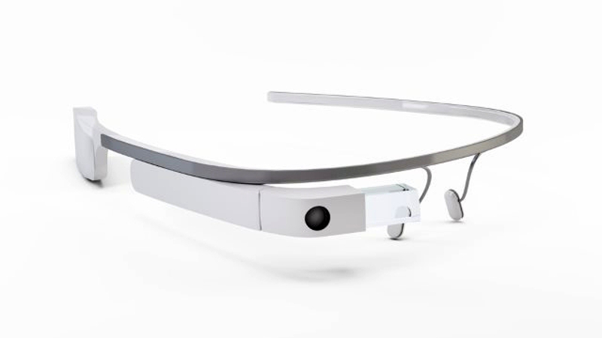
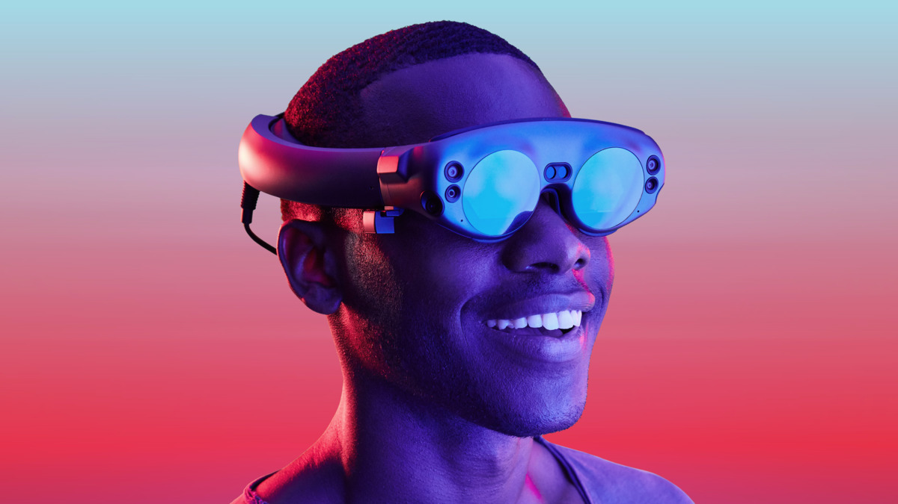
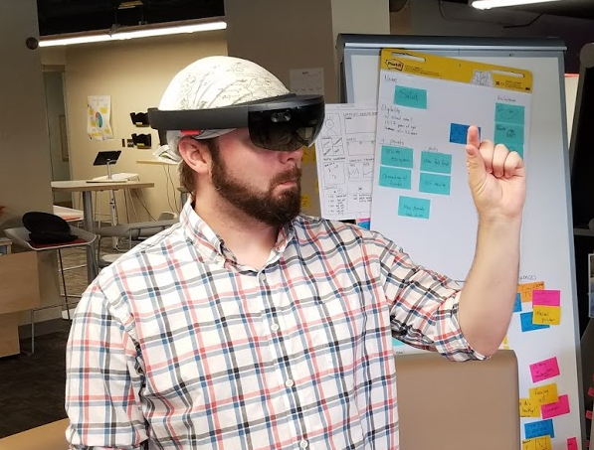
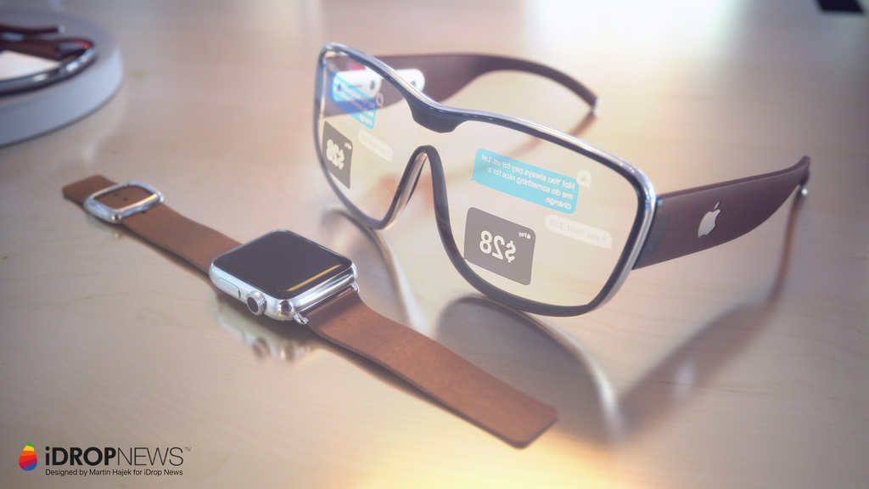
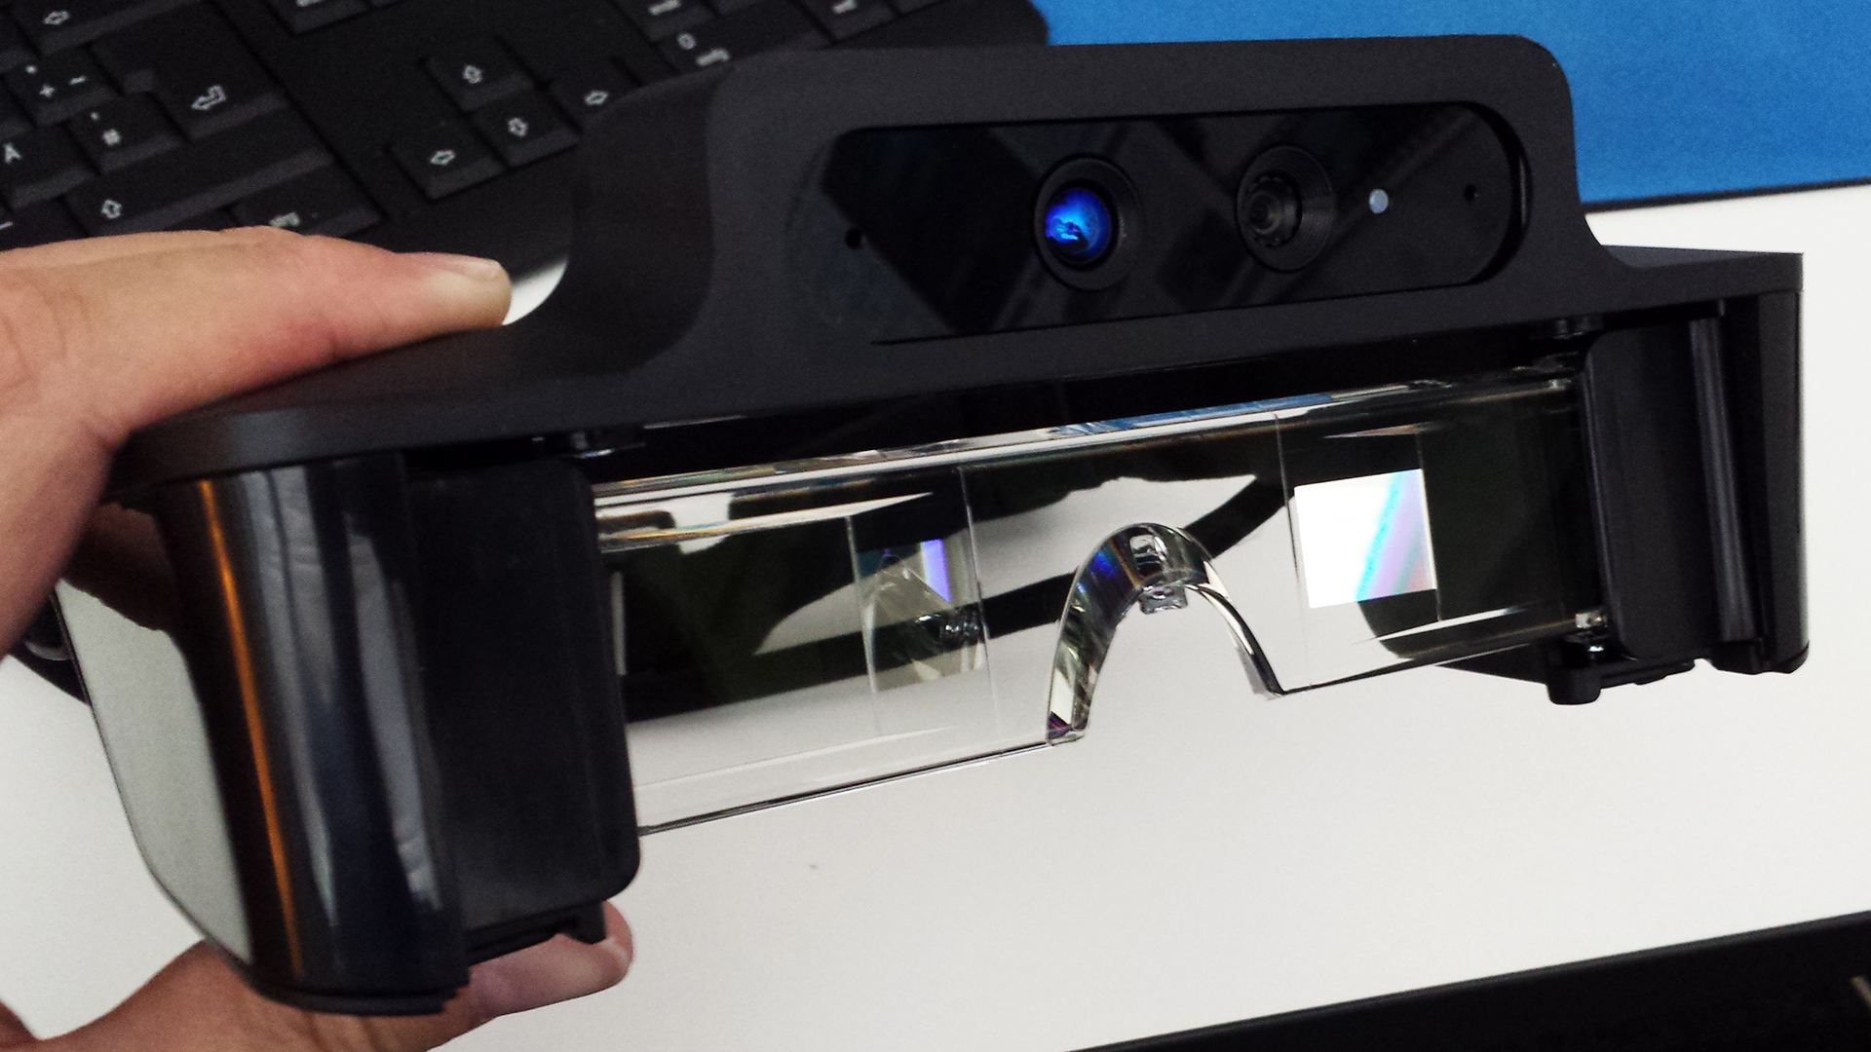
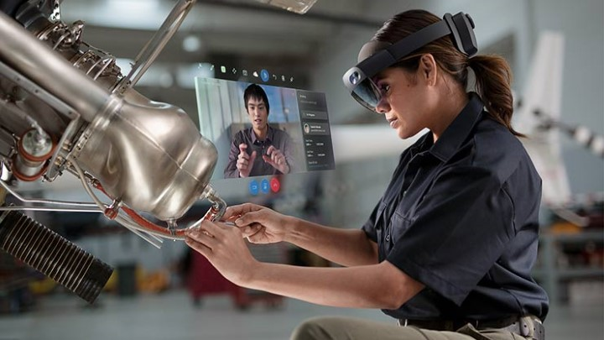
2013
2015
2019
2021?
Maybeeee???
Notes:
Development in the AR hardware market is extremely rapid. The earliest devices were interesting technology demos, but ultimately only useful in very limited scenarios. Today, we have extremely useful devices that are somewhat bulky and cumbersome. It’s very easy to imagine—at the current trajectory—that we will have very comfortable, very capable devices within a few, short years.
Google Glass, Meta 1 Dev Kit (2013)
Hololens 1 (2015)
ODG R-9 (2017)
Magic Leap, HoloLens 2 (20179

Slide 31
How? Lot’s of ways
Microsoft Windows Mixed Reality
Magic Leap
Vuforia
Google ARCore
Apple ARKit
Notes:
So how could one get started in AR software development?

Slide 32

Windows Mixed Reality - https://www.microsoft.com/en-us/hololens
Pros
Support for both VR and AR
Free to develop
Excellent tracking with no external hardware
Excellent documentation
Wearable, keeping hands free for work
Hand-tracking built-in
Voice recognition built-in
Solid surface detection
Huge Windows API for lots of other advanced functionality
Desktop metaphor for running standard 2D apps
Cons
Expensive (US $3500)
HoloLens 1 – short battery life
HoloLens 2 – limited availability
Hand gestures provide no haptic feedback

Slide 33

Magic Leap - https://www.magicleap.com/
Pros
Free to develop
Wearable, keeping hands free for work
Hand-tracking built-in
Controller with haptic feedback available
Excellent battery life
Cons
Expensive (US $2300)
“Compute Pack” worn on hip
No voice recognition (yet)
Documentation is limited
Updates are slow
Company is in trouble

Slide 34

Vuforia - https://vuforia.com/
Pros
Cons
Popular in mobile AR market
Excellent Unity integration
3D model recognition
2D image target recognition
Supports most smartphones (both Android and iOS)
Somewhat expensive at scale
Not at all open source
Requires use of their services
Smartphones and tablets need to be held

Slide 35

Google ARCore - https://developers.google.com/ar/
Pros
Cons
Free to develop
Excellent Unity integration
Solid surface detection, no markers required
2D image detection
Supports most modern smartphones
Lots of new features released regularly
Smartphones and tablets need to be held
Doesn’t support older phones
Documentation is limited

Slide 36

Apple ARKit - https://developer.apple.com/arkit/
Pros
Cons
Very similar to ARCore
Excellent Unity integration
Solid surface detection, no markers required
2D image detection
Supports most iPhones and iPads
Lots of new features released regularly
Costs $100/yr to develop
Requires Apple computer to develop
Apple devices only
Apps must be deployed through App Store
Smartphones and tablets need to be held

Slide 37
How to choose?
Windows Mixed Reality
You need best-in-class tracking
You need advanced application features like voice recognition
You need the user’s hands to be free
Magic Leap
You can’t quite afford a HoloLens
You need the user’s hands to be free
You don’t mind carrying a brick on your hip
Vuforia
You don’t need hands to be free
You need to support lots of devices that users already own
You want to augment images or complex 3D models
Google ARCore
You don’t need hands to be free
You want to support devices users already own
Apple ARKit
You like ARCore’s features and you don’t mind being locked into Apple’s ecosystem

Slide 38
Thanks!
Notes:
In summary, the market for AR software is still very early, but we are already seeing amazing results. I continue to feel as I have for the last five years: now is the time to get involved, get one’s feet wet in AR, and start building the applications of the future.
Thank you.

